Slide 1
Why we need Optimization?
Cause we are engineers
Then again we
Must have to consider the limitations of the physical world
Must keep the cost down
Need to confront optimization problem to balance performance and limitations

Slide 2
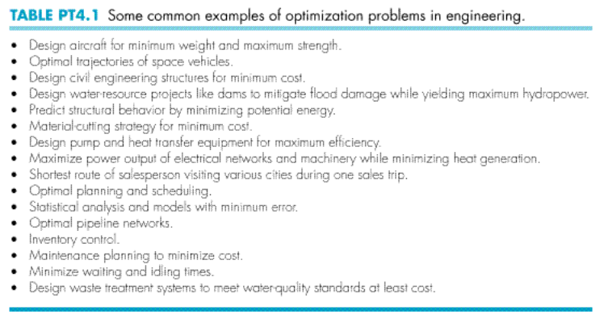
Some Examples

Slide 3
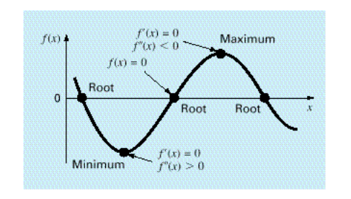
Similarity between Root Finding and Optimization

Slide 4
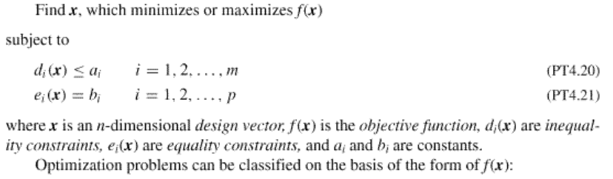
Generic Form of An Optimization Problem

Slide 5
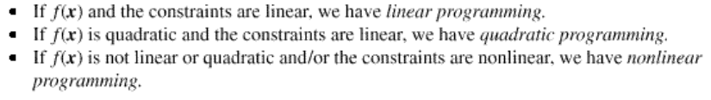
Linear vs Quadratic vs Nonlinear Programming

Slide 6
Constrained vs Unconstrained Optimization

Slide 7
Unconstrained Optimization

Slide 8
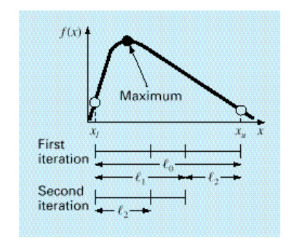
Golden-Section Search

Slide 9
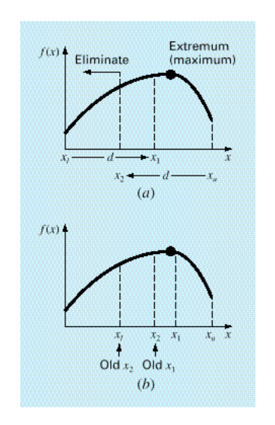
Golden-Section Search

Slide 10
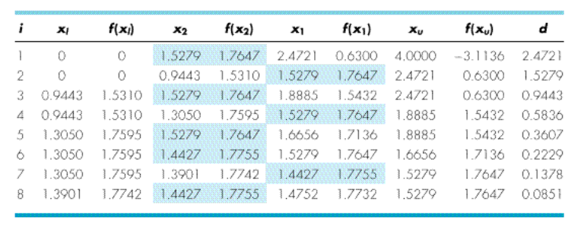
Golden-Section Search

Slide 11

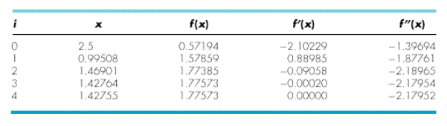
Newton’s Method

Slide 12
Constrained Optimization
Simplex Method

Slide 13
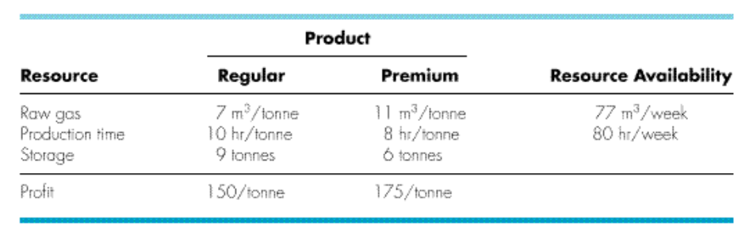
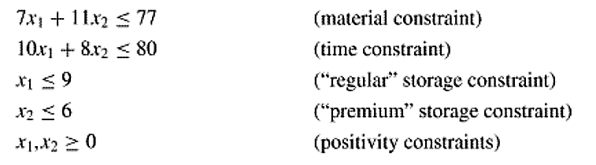

Slide 14
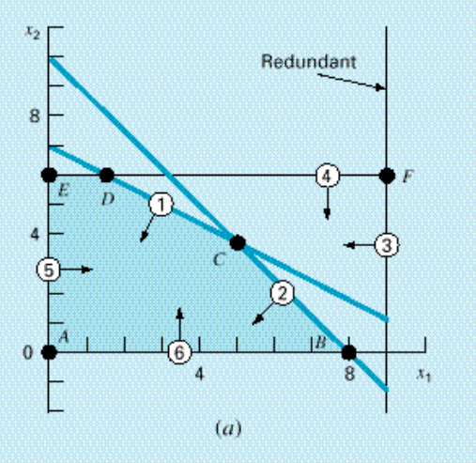
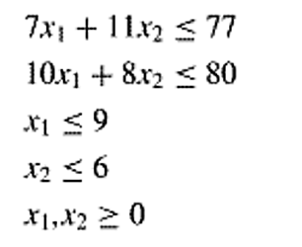

Slide 15
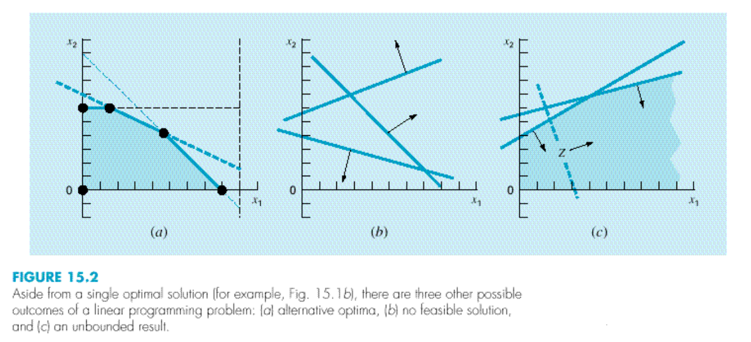

Slide 16
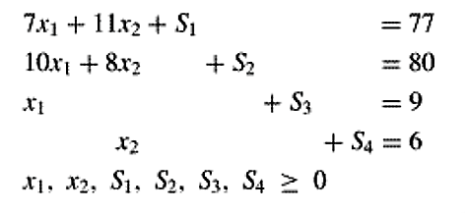

Slide 17
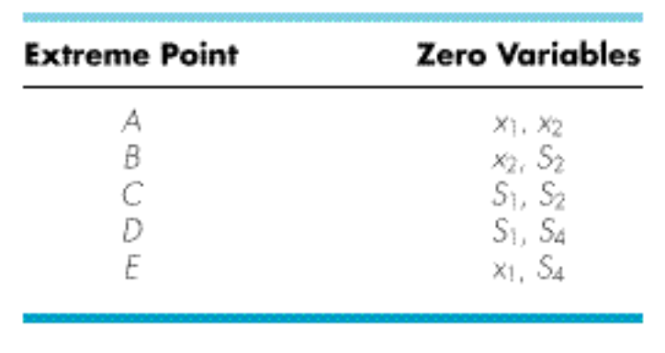

Slide 18
Step 1: Form the initial tableu
Step 2: If all variables have a nonnegative coefficient in Row 0, the current basic solution is optimal.
Select a non-basic (zero) variable to turn into basic (non-zero) which has a negative coefficient in the objective function row. (In this case we select x₁)
Step 3: Calculate intercept. (Solution/The variable of step 2)
Step 4: A basic (nonzero) variable having the smallest intercept is made non-basic(zero). Replace the previous basic variable with the variable of step 2. (In this case S₂)
Step 5: Make the pivot element 1. Apply Gauss-Jordan elimination on the tableau so that other elements of the variable of step 2 (In this case x₁) column is zero. Go to step 2.

Slide 19
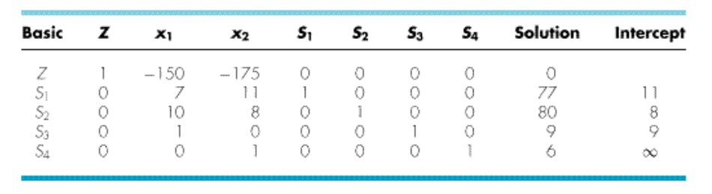

Slide 20
Step 1: Form the initial tableu
Step 2: If all variables have a nonnegative coefficient in Row 0, the current basic solution is optimal.
Select a non-basic (zero) variable to turn into basic (non-zero) which has a negative coefficient in the objective function row. (In this case we select x₁)
Step 3: Calculate intercept. (Solution/The variable of step 2)
Step 4: A basic (nonzero) variable having the smallest intercept is made non-basic(zero). Replace the previous basic variable with the variable of step 2. (In this case S₂)
Step 5: Make the pivot element 1. Apply Gauss-Jordan elimination on the tableau so that other elements of the variable of step 2 (In this case x₁) column is zero. Go to step 2.

Slide 22
Step 1: Form the initial tableu
Step 2: If all variables have a nonnegative coefficient in Row 0, the current basic solution is optimal.
Select a non-basic (zero) variable to turn into basic (non-zero) which has a negative coefficient in the objective function row. (In this case we select x₁)
Step 3: Calculate intercept. (Solution/The variable of step 2)
Step 4: A basic (nonzero) variable having the smallest intercept is made non-basic(zero). Replace the previous basic variable with the variable of step 2. (In this case S₂)
Step 5: Make the pivot element 1. Apply Gauss-Jordan elimination on the tableau so that other elements of the variable of step 2 (In this case x₁) column is zero. Go to step 2.

Slide 24
Step 1: Form the initial tableu
Step 2: If all variables have a nonnegative coefficient in Row 0, the current basic solution is optimal.
Select a non-basic (zero) variable to turn into basic (non-zero) which has a negative coefficient in the objective function row. (In this case we select x₁)
Step 3: Calculate intercept. (Solution/The variable of step 2)
Step 4: A basic (nonzero) variable having the smallest intercept is made non-basic(zero). Replace the previous basic variable with the variable of step 2. (In this case S₂)
Step 5: Make the pivot element 1. Apply Gauss-Jordan elimination on the tableau so that other elements of the variable of step 2 (In this case x₁) column is zero. Go to step 2.

Slide 26
Step 1: Form the initial tableu
Step 2: If all variables have a nonnegative coefficient in Row 0, the current basic solution is optimal.
Select a non-basic (zero) variable to turn into basic (non-zero) which has a negative coefficient in the objective function row. (In this case we select x₁)
Step 3: Calculate intercept. (Solution/The variable of step 2)
Step 4: A basic (nonzero) variable having the smallest intercept is made non-basic(zero). Replace the previous basic variable with the variable of step 2. (In this case S₂)
Step 5: Make the pivot element 1. Apply Gauss-Jordan elimination on the tableau so that other elements of the variable of step 2 (In this case x₁) column is zero. Go to step 2.

Slide 27
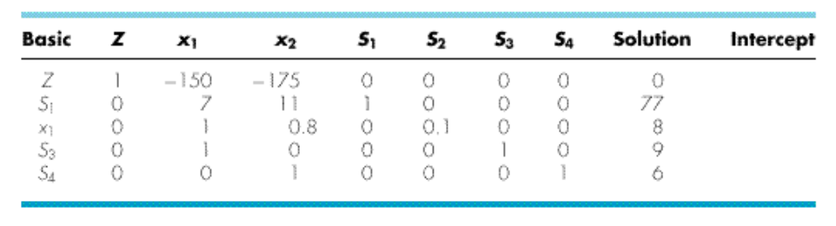

Slide 28
Step 1: Form the initial tableu
Step 2: If all variables have a nonnegative coefficient in Row 0, the current basic solution is optimal.
Select a non-basic (zero) variable to turn into basic (non-zero) which has a negative coefficient in the objective function row. (In this case we select x₁)
Step 3: Calculate intercept. (Solution/The variable of step 2)
Step 4: A basic (nonzero) variable having the smallest intercept is made non-basic(zero). Replace the previous basic variable with the variable of step 2. (In this case S₂)
Step 5: Make the pivot element 1. Apply Gauss-Jordan elimination on the tableau so that other elements of the variable of step 2 (In this case x₁) column is zero. Go to step 2.

Slide 29
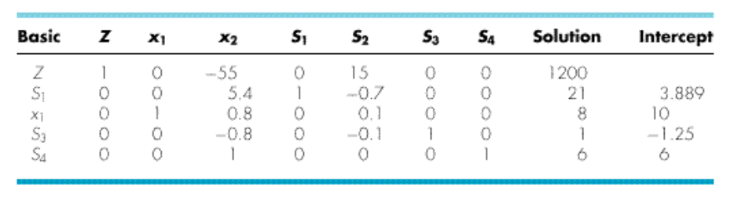

Slide 30
Step 1: Form the initial tableu
Step 2: If all variables have a nonnegative coefficient in Row 0, the current basic solution is optimal.
Select a non-basic (zero) variable to turn into basic (non-zero) which has a negative coefficient in the objective function row. (In this case we select x₁)
Step 3: Calculate intercept. (Solution/The variable of step 2)
Step 4: A basic (nonzero) variable having the smallest intercept is made non-basic(zero). Replace the previous basic variable with the variable of step 2. (In this case S₂)
Step 5: Make the pivot element 1. Apply Gauss-Jordan elimination on the tableau so that other elements of the variable of step 2 (In this case x₁) column is zero. Go to step 2.

Slide 31
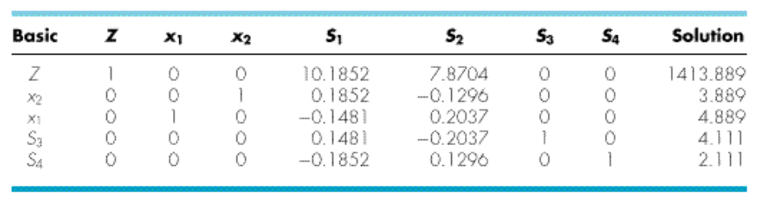

Slide 32
Reference
Chapra and Canale - Numerical Methods for Engineers (4th edition)
Chapter 13.1, 13.3, 15.1

